Slide 1
“Linear Data Structure using Squential Organization”
1

Slide 2

SYLLABUS
Concept of Sequential Organization, Overview of Array, Array as an Abstract Data Type, Operations on Array, Merging of two arrays, Storage Representation and their Address Calculation: Row major and Column Major, Multidimensional Arrays: Two-dimensional arrays, n-dimensional arrays. Concept of Ordered List,
Single Variable Polynomial: Representation using arrays, Polynomial as array of structure, Polynomial addition, Polynomial multiplication.
Sparse Matrix: Sparse matrix representation using array, Sparse matrix addition, Transpose of sparse matrix- Simple and Fast Transpose, Time and Space tradeoff.
2

Slide 3

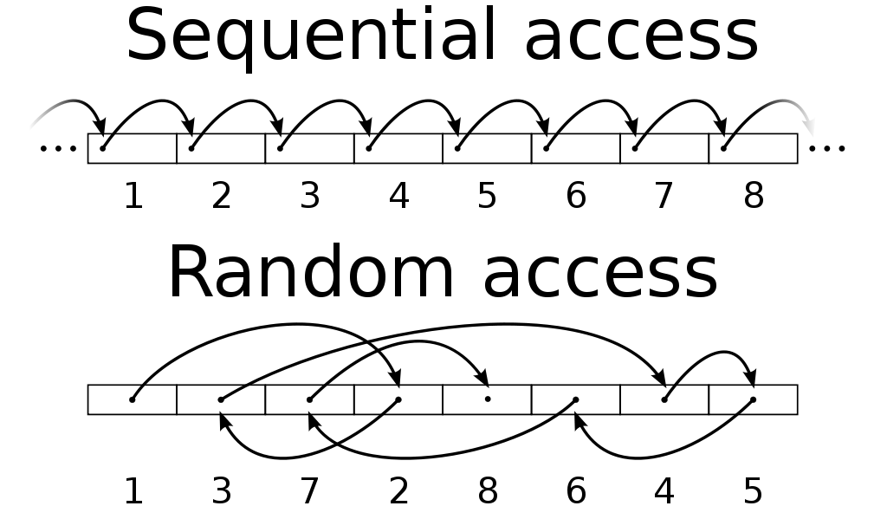
SEQUENTIAL ORGANIZATION
Definition :
“In computer science, sequential access means that a group of elements (such as data in a memory array or a disk file or on magnetic tape data storage) is accessed in a predetermined, ordered sequence.Sequential access is sometimes the only way of accessing the data, for example if it is on a tape.”
3

Slide 4
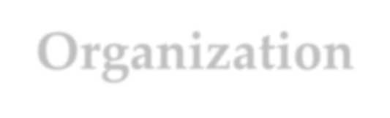
Linear Data Structure Using Sequential Organization
Definition :
“The data structure where data items are organized sequentially or linearly one after another is called as Linear Data Structure”
A linear data structuretraverses the data elements sequentially, in which only one data element can directly be reached. Ex: Arrays, Linked Lists.
4

Slide 5
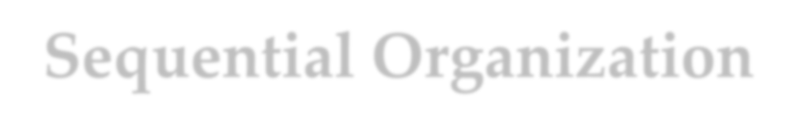
Sequential Organization
In a sequential organization, the elements or components of the system are arranged in a specific order, and each element depends on the previous one.
Sequential organization has the advantage of fast access to elements, but has the disadvantage of slow insertion and deletion of elements, especially when the data is stored in a contiguous block of memory.
5

Slide 6
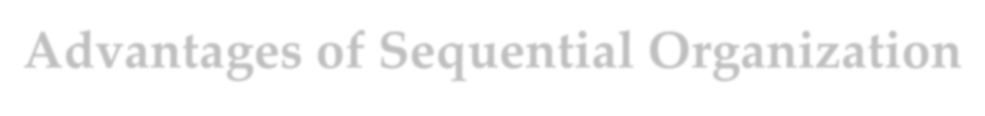
Advantages of Sequential Organization
Easy to understand
Simple to implement
Allow for fast traversal and access
Random access is possible
Suitable for static data structure
Can be used for other data structure like Array, Stack etc
6

Slide 7

Disadvantages of Sequential Organization
Fixed size structure
Not suitable for dynamic data structure.
Insertion and deletion is difficult
Only linear sequential list is possible
Fixed length data in each element.
Not suitable for large list
7

Slide 8
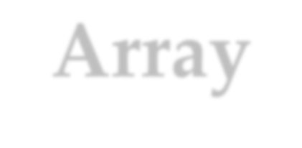
Array
Definition :
“An array is a finite ordered collection of homogeneous data elements which provides direct access (or random access) to any of its elements.
An array as a data structure is defined as a set of pairs (index,value) such that with each index a value is associated.
index — indicates the location of an element in an array.
value - indicates the actual value of that data element.
Declaration of an array in ‘C++’:
int Array_A[20];
”
8

Slide 9
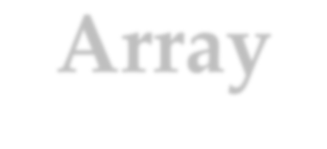
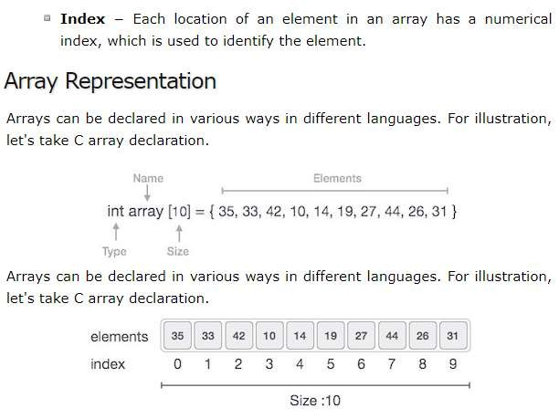
Array
Array Representation
Arrays can be declared in various ways in different languages. For illustration, let's take C array declaration.
Arrays can be declared in various ways in different languages. For illustration, let's take C array declaration.
As per the above illustration, following are the important points to be considered.
9

Slide 10
Array
Array Representation
Index starts with 0.
Array length is 10 which means it can store 10 elements.
Each element can be accessed via its index. For example, we can fetch an element at index 6 as 9.
Basic Operations
Following are the basic operations supported by an array.
Traverse − print all the array elements one by one.
Insertion − Adds an element at the given index.
Deletion − Deletes an element at the given index.
Search − Searches an element using the given index or by the value.
Update − Updates an element at the given index.
10

Slide 11
Introduction to arrays
Representation and analysis Type variable_name[size]
Operations with arrays:
Copy Delete
Insert Search Sort
Merging of sorting arrays.

Slide 12
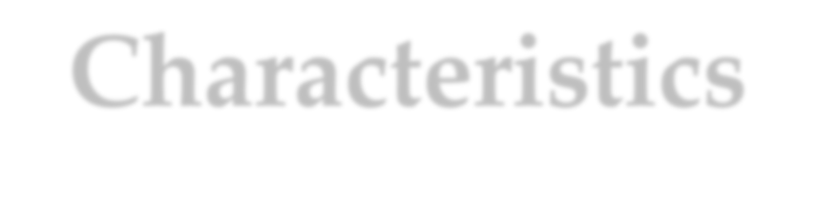
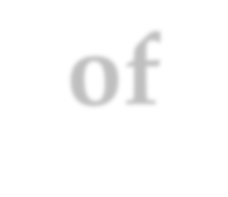
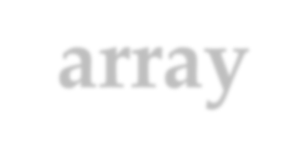
Characteristics of array
An array is a finite ordered collection of homogeneous data elements.
In array, successive elements of list are stored at a fixed distance apart.
Array is defined as set of pairs-( index and value).
Array allows random access to any element
In array, insertion and deletion of element in between positions requires data movement.
Array provides allocation done changed run time.
static allocation, which means space once during compile time, can not be
12

Slide 13
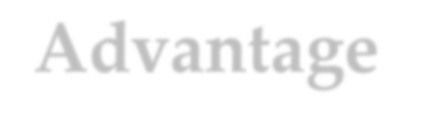
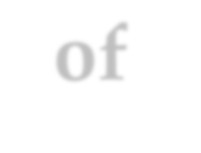
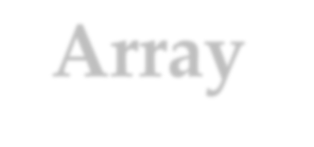
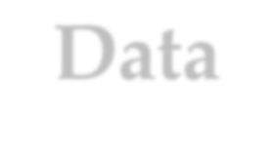
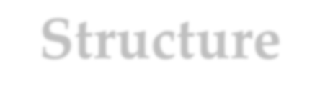
Advantage of Array Data Structure
In an array, accessing an element is very easy by using the index number.
The search process can be applied to an array easily.
2D Array is used to represent matrices.
For any reason a user wishes to store multiple values of similar type then the Array can be used and utilized efficiently.
Arrays have low overhead.
C provides a set of built-in functions for manipulating arrays, such as sorting and searching.
C supports arrays of multiple dimensions, which can be useful for representing complex data structures like matrices.
Arrays can be easily converted to pointers, which allows for passing arrays to functions as arguments or returning arrays from functions.
13

Slide 14
Advantage of Array Data Structure
Array size is fixed. which means you cannot add/delete elements after creation.
Array is homogenous. cannot store values of different data types in a single array.
Array is Contiguous blocks of memory.
Another disadvantage of arrays is that they don't support random access.
Insertion and deletion are not easy in Array.
Wastage of memory space if all array elements are not used.
7. Array have limited functionality compared to other data structure

Slide 15
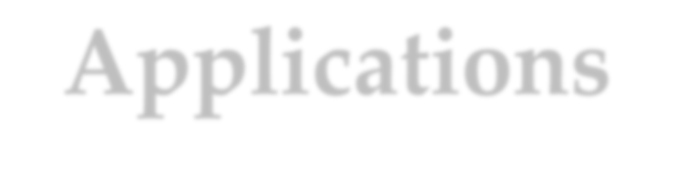
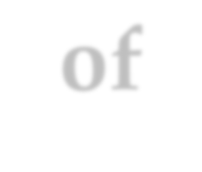
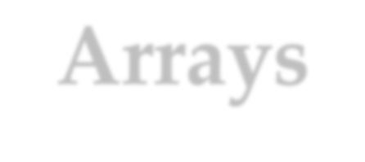
Applications of Arrays
Below are some applications of arrays.
Storing and accessing data: Arrays are used to store and retrieve data in a specific order. For example, an array can be used to store the scores of a group of students, or the temperatures recorded by a weather station.
Sorting: Arrays can be used to sort data in ascending or descending order. Sorting algorithms such as bubble sort, merge sort, and quicksort rely heavily on arrays.
3. Searching: Arrays can be searched for specific algorithms such as linear search and binary search.
elements
using
15
15

Slide 16
Applications of Arrays
Below are some applications of arrays.
Matrices: Arrays are used to represent matrices in mathematical computations such as matrix multiplication, linear algebra, and image processing.
Stacks and queues: Arrays are used as the underlying data structure for implementing stacks and queues, which are commonly used in algorithms and data structures.
Graphs: Arrays can be used to represent graphs in computer science. Each element in the array represents a node in the graph, and the relationships between the nodes are represented by the values stored in
_{the}PR_{a}O_{r}F._{r}A_{a}N_{y}A.ND GHARU
16
16

Slide 17
Abstract Data Type as an Array
C/C++ provides Array as a basic data structure.
Representation of data is defined by the language compiler itself. But the operations on the data are not defined by the compiler.
We have to implement or provide the operations on Array data structure. So, data structure array and the set of operations together we can call it as Abstract Data Type (ADT)

Slide 18
Abstract Data Type as an Array
ADT indicates for Abstract Data Type.
Arrays are defined as ADT’s because they are capable of holding contiguous elements in the same order. And they permit
access for the specific element via index or position.
They are abstract because they can be String, int or Person
Example :
int[] arrA = new int[1]; String[] arrB = new String[1];
Person[] arrC = new Person[3]; // where Person is treated as a defined class

Slide 19
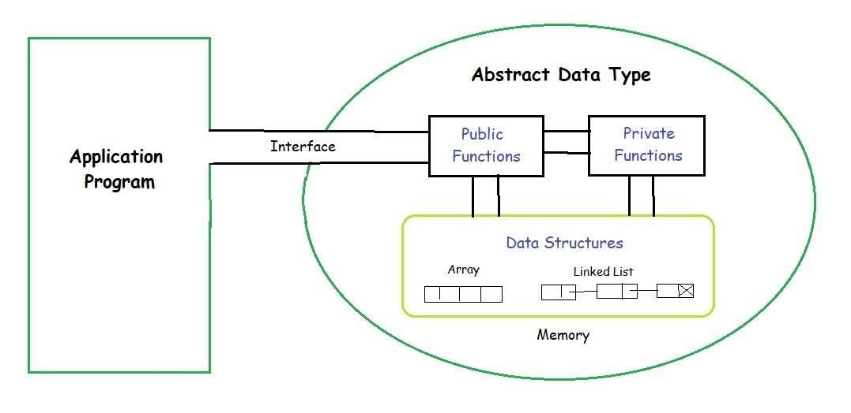
Abstract Data Type as an Array
The process of providing only the essentials and hiding the details is known as abstraction.

Slide 20
OPERATION OF ARRAY
Display () – To Display the entire array on the screen.
Add(n) / Append(n) – To add a particular element on the end of the array.
Insert (index, n) – To add an element to a particular index.
Delete (index) – To delete an element with the help of an index in the given array.
Search (n) – To check whether the given element is present or not in an array.
Get (index) – It will return the element which presents on the given index.
Set (index, x) – It will change the element with the new element at a particular index.
Max () / Min () – These will return the max and min element in the given array.
Reverse () – It will reverse the order of elements in the given array.
Shift () – It will shift the whole elements either on the left or right side by the given number.

Slide 21
MERGING OF TWO ARRAY
The primary goal is to merge two sorted arrays in ascending order and display the results as output.
Combining two arrays into a single array is known as merging two arrays. For example, if the first array has 5 elements and the second array has 4, the resultant array will have 9 elements. A merged array is the result of this process.
If you are unfamiliar with the concept of an array, let's see the example :

Slide 22
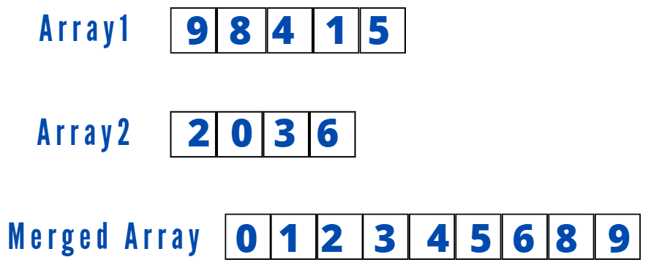
MERGING OF TWO ARRAY
If you are unfamiliar with the concept of an array, let's see the example :
Input:
1st Array 1: 9 8 4 1 5
2nd Array 2: 2 0 3 6
Output : The merged sorted Array : 0 1 2 3 4 5 6 8 9

Slide 23
MERGING OF TWO ARRAY
Program 1: Using the + operator
With the help of the + operator, We can merge two arrays. The + operator concatenates the elements of two arrays into a single array. Below is the program.
arr1 = [1, 2, 3]
arr2 = [4, 5, 6]
merged_arr = arr1 + arr2
print("Array After Merging =",merged_arr)
Python Output:
Array After Merging = [1, 2, 3, 4, 5, 6]

Slide 24
Reverse Array in Python
#Initialize array
arr = [1, 2, 3, 4, 5];
print("Original array: "); for i in range(0, len(arr)):
print(arr[i]),
print("Array in reverse order: ");
#Loop through the array in reverse order for i in range(len(arr)-1, -1, -1):
print(arr[i])
Output:
Original array:
1 2 3 4 5
Array in reverse order:
5 4 3 2 1

Slide 25
Count key using Array in Python
# Python code to count the number of occurrences of key element
def countX(lst, key): count = 0
for ele in lst:
if (ele == key): count = count + 1
return count
# Driver Code
lst = [8, 6, 8, 10, 8, 20, 10, 8, 8]
key = 8
print('{} has occurred {} times'.format(key, countX(lst, key)))
Output : 8 has occurred 5 times

Slide 26
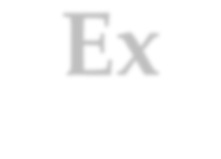

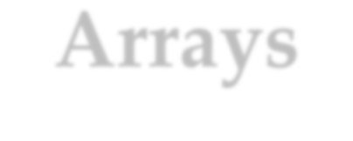
Ex-Arrays
#include <stdio.h>
int main ()
{
int a[10],i,size;
printf(“\nhow many no of elements u want to scan”); scanf(“%d”,&size);
printf(“\nEnter the elements in the array”); for(i=0;i<size;i++)
{
scanf(“%d”,&a[i]);
} //end for for(i=0;i<size;i++)
{
printf(“The array is %d”,a[i]); //Displaying Array
} //end for return 0;

Slide 27

Output will be
1
2
3
4
5

Slide 28
Copy operation
#include <stdio.h>
•
int main()
{
int a[100],b[100] position, c n;
•
•
•
•
•
•
•
•
printf("Enter number of elements in array\n"); scanf("%d", &n);
printf("Enter %d elements\n", n);
for ( c = 0 ; c < n ; c++ ) scanf("%d", &a[c]);
printf("Enter %d elements\n", n);
•
•
•
for( c = 0 ; c < n - 1 ; c++ )
printf("%d\n", a[c]);
//Coping the element of array a to b
for( c = 0 ; c < n - 1 ; c++ )
{
b[c]=a[c];
}
}
•
•
}
return 0;

Slide 29
Output
•
•
Enter number of elements in array -4
•
Enter 4 elements
•
1
• | 2
• | 3
• | 4
• • | 1 | displaying array a
• | 2
• | 3
• | 4
• | displaying array b
• | 1
• | 2
• | 3
• | 4
•

Slide 30
Delete operation
#include <stdio.h>
•
•
•
•
•
•
•
•
•
•
•
•
•
•
•
•
•
int main()
{
int array[100], position, i, n;
printf("Enter number of elements in array\n"); scanf("%d", &n);
printf("Enter %d elements\n", n);
for ( i = 0 ; i < n ; i++ ) scanf("%d", &array[i]);
printf("Enter the location where you wish to delete element\n"); scanf("%d", &position);
for ( i = position ; i < n; i++ )
{
•
array[i] = array[i+1];
•
•
•
•
}
printf("Resultant array is\n");
for( i = 0 ; i < n-1 ; i++ )
•
•
}
printf("%d\n", array[i]);
return 0;

Slide 31
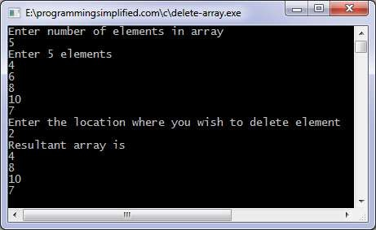
Delete operation

Slide 32
Inserting an element
#include <stdio.h>
int main()
{
int array[100], position, i, n, value;
printf("Enter number of elements in array\n"); scanf("%d", &n);
printf("Enter %d elements\n", n); for (i= 0;i< n; i++)
scanf("%d", &array[i]);
printf("Enter the location where you wish to insert an element\n"); scanf("%d", &position);
printf("Enter the value to insert\n"); scanf("%d", &value);
for (i = n - 1; i >= position ; i--)
array[i+1] = array[i];
array[position] = value; printf("Resultant array is\n");
for (i= 0; i <= n; i++)
printf("%d\n", array[i]); return 0;

Slide 33
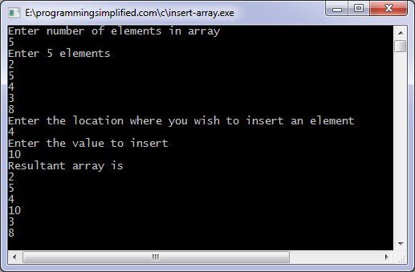
Inserting an element

Slide 34
Sort an array
Int a[10]={5,4,3,2,1}
for(i=0;i<n-1;i++)
{
for(j=0;j<=n-1;j++)
{
if(a[j]>a[j+1])
{
temp=a[i]; a[i]=a[j]; a[j]=temp;
}
}

Slide 35
Reverse array in C
#include <stdio.h>
int main() {
int array[100], n, i, temp, end;
scanf("%d", &n); end = n - 1;
for (i = 0; i < n; i++) { scanf("%d", &array[i]);
}
for (i= 0; < n/2; i++)
{
temp = array[i]; array[i] = array[end]; array[end] = temp;
end--;
}
printf("Reversed array elements are:\n"); for ( i= 0; i < n; i++) {
printf("%d\n", array[i]);
}
return 0;
}

Slide 36
Sort element using array
int a[10]={5,4,3,2,1}
for(i=0;i<n;i++) for(j=i+1;j<n;j++)
{
if(a[i]>a[j])
{
temp=a[i]; a[i]=a[j]; a[j]=temp;
}
}

Slide 37
Storage Representation of Array
Note : As we have already studied and discussed Basic concepts of array, representation, operation, 1-D array etc.
Here, we will see types of array and their address calculation.
Types of Arrays
The various types of arrays are as follows.
One dimensional array
Two dimensional array
Multi-dimensional array
One-Dimensional Array
A one-dimensional array is also called a single-dimensional array where the elements will be accessed in sequential order. This type of array will be accessed by the subscript of either a column or row index

Slide 38
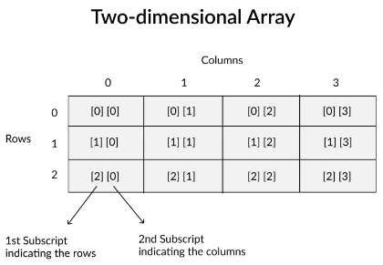
Storage Representation of Array
Multi-Dimensional Array :
When the number of dimensions specified is more than one, then it is called as a multi-dimensional array. Multidimensional arrays include 2D arrays and 3D arrays.

Slide 39
Storage Representation of Array
Multi-Dimensional Array :
A two-dimensional array will be accessed by using the subscript of row and column index. For traversing the two-dimensional array, the value of the rows and columns will be considered. In the two-dimensional array face [3] [4], the first index specifies the number of rows and the second index specifies the number of columns and the array can hold 12 elements (3 * 4).
Similarly, in a three-dimensional array, there will be three dimensions. The array face [5] [10] [15] can hold 750 elements (5 * 10 * 15).

Slide 40
1-D & 2-D dimensional Arrays Syntax
One dimensional array declaration
type arrayname[size];
e.g. int array[10]
Multidimensional array is the two-dimensional array
type arrayName [ size_row ][ size_col ];
e.g. int array[3] [3];
Multidimensional array is the three-dimensional array
type arrayName [ size ][ size ][ size ];;

Slide 41
Storage Representation of Array
Declaration/Initialization of Arrays
// A sample program for Array Declaration
#include <stdio.h> int main()
{
int one_dim [10]; # declaration of 1D array int two_dim [2][2]; #declaration of 2D array int three_dim [2][3][4] = {
{ {3, 4, 2, 3}, {0, -3, 9, 11}, {23, 12, 23, 2} },
{ {13, 4, 56, 3}, {5, 9, 3, 5}, {3, 1, 4, 9} }
}; #declaration of 3D array. Here the elements are also defined.return 0;
}

Slide 42
m-no of rows
n-no of columns
Printf(“\n Enter the rows and columns”); Scanf(%d %d”,&m,&n);
for(i=0;i<m;i++)
{
for(j=0;j<n;j++)
{
Printf(“\n Enter the value of(%d)(%d)=“,i,j);
Scanf(“%d”,&a[i][j]);
}
}

Slide 43
for(i=0;i<m;i++)
{
Printf(“\n”); for(j=0;j<n;j++)
{
printf(“%d”,&a[i][j]);
}
}

Slide 44
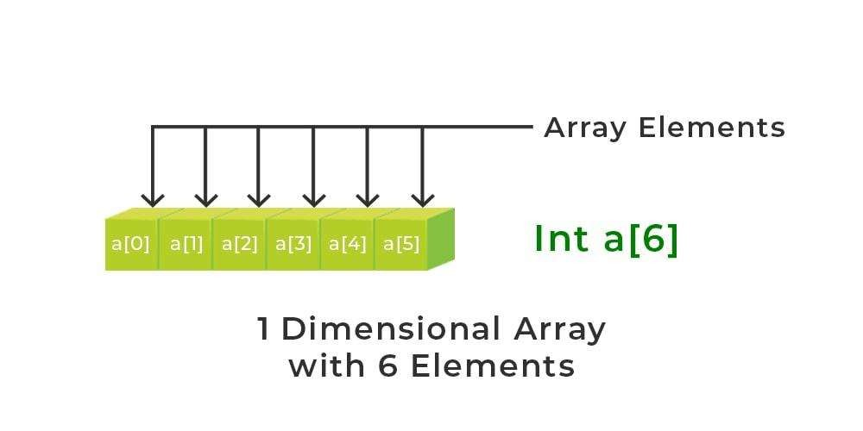
1-D ADDRESS CALCULATION
Calculating the address of any element In the 1-D array:
A 1-dimensional array (or single-dimension array) is a type of linear array. Accessing its elements involves a single subscript that can either represent a row or column index.
2
44
4
4

Slide 45
1-D ADDRESS CALCULATION
To find the address of an element in an array the following formula is used-
Address of A[I] = B + W * (I – LB)
I = Subset of element whose address to be found, B = Base address,
W = Storage size of one element store in any array(in byte),
LB = Lower Limit/Lower Bound of subscript(If not specified
assume zero).
2
45
45

Slide 46
1-D ADDRESS CALCULATION
Example: Given the base address of an array A[1300 ………… 1900] as 1020 and the size of each element is 2 bytes in the memory, find the address of A[1700].
Solution: Given:
Base address B = 1020
Lower Limit/Lower Bound of subscript LB = 1300 Storage size of one element store in any array W = 2 Byte
Subset of element whose address to be found I = 1700 Formula used: Address of A[I] = B + W * (I – LB)
Solution:
Address of A[1700] = 1020 + 2 * (1700 – 1300)
= 1020 + 2 * (400)
= 1020 + 800
2
Address of A[1700] = 1820
46
4
6

Slide 47
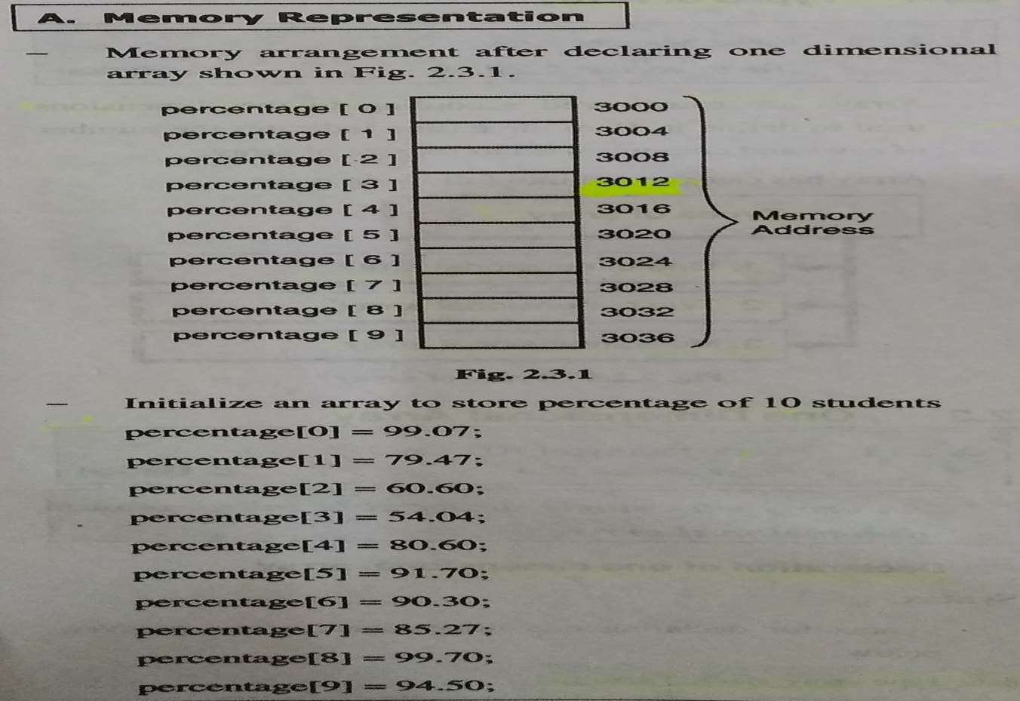





Memory Representation and Calculation
X(Base)
X+1
Fig 2.1 Memory Representation
47
4
7

Slide 48
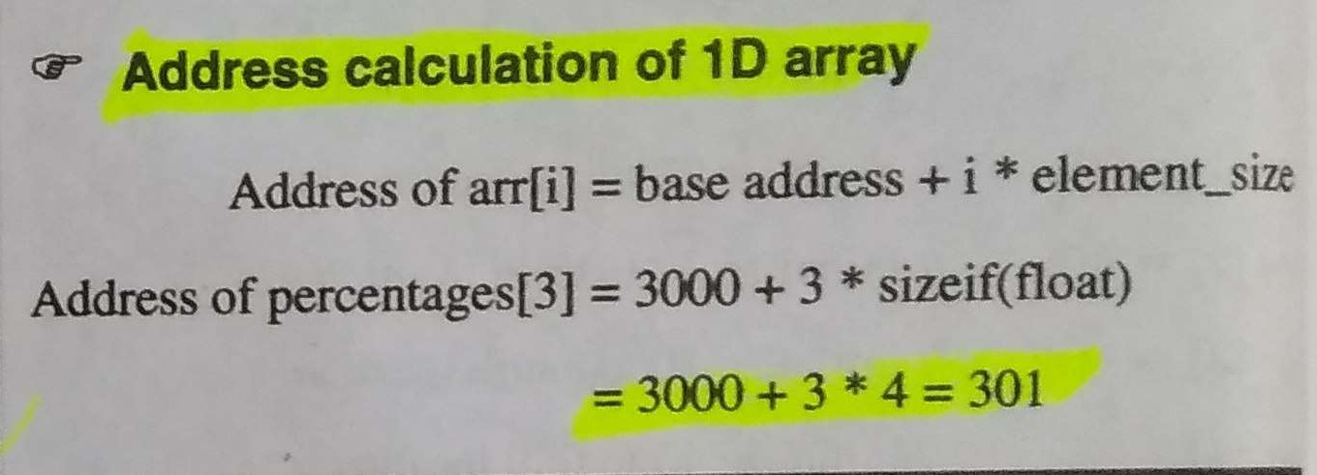
ADDRESS CALCULATION
The address of the i^{th} element is calculated by the following formula
(Base address) + (offset of the i^{th} element from base address)
Here, base address is the address of the first element where array storage starts.
2
48 ₄
8

Slide 49
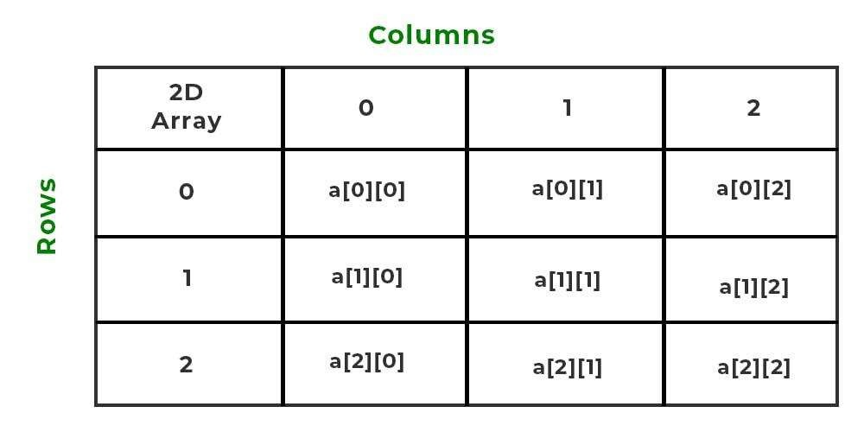
2-D ADDRESS CALCULATION
The 2-dimensional array can be defined as an array of arrays. The 2-Dimensional arrays are organized as matrices which can be represented as the collection of rows and columns as array[M][N] where M is the number of rows and N is the number of columns.
2
49
4
9

Slide 50
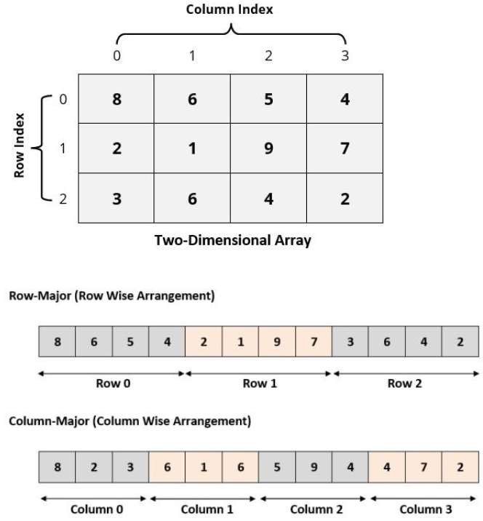
Row major & Col major Representation
50
5
0

Slide 51
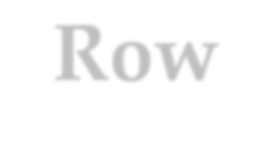

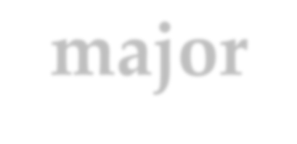
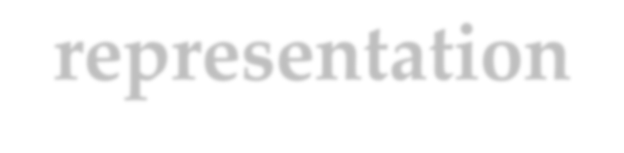
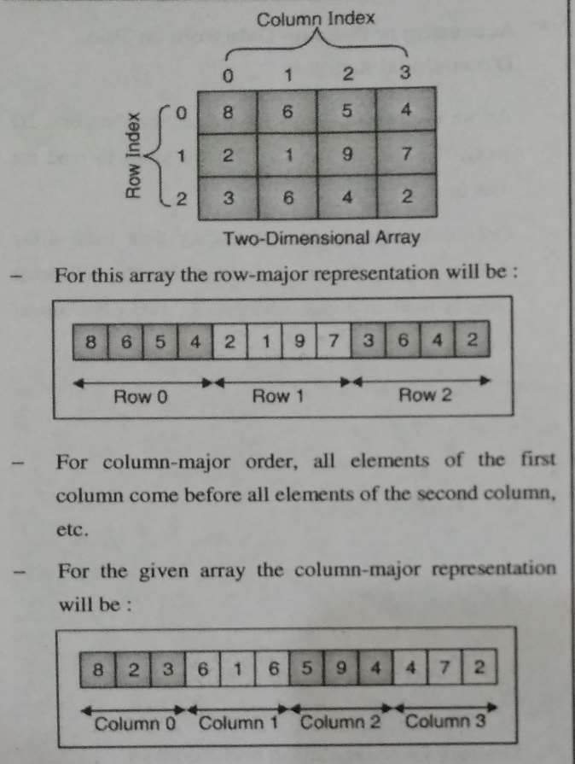
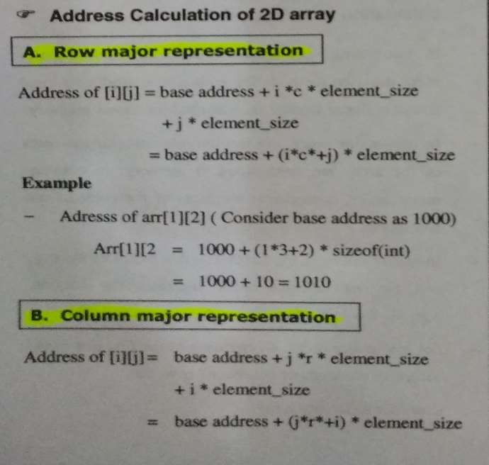
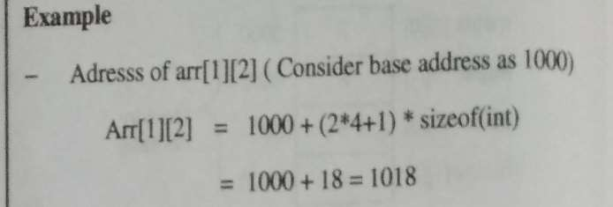
Row-major representation

Slide 52



CONCEPT OF ORDERED LIST
Ordered list is the most common and frequently used data object
Linear elements of an ordered list are related with each other in a particular order or sequence
Following are some examples of theordered list.
1, 3,5,7,9,11,13,15
January, February, March, April, May, June, July,
August, September,
October, November, December
Red, Blue, Green, Black, Yellow

Slide 53




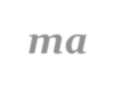









There are many basic operations that can be performed on the ordered list asfollows:
Finding the length of the list
Traverse the list from left to right or from right to left
Access the ith element in thelist
Update (Overwrite) the value of position
Insert an element at the ith location
Delete an element at the ith position
the ith

Slide 54



SINGLE VARIABLE POLYNOMIAL
A polynomial p(x) is the expression in variable x which is in the form (ax^{n} + bx^{n-1} + ….
+ jx+ k), where a, b, c …., k fall in the category of real numbers and 'n' is non negative integer, which is called the degree of polynomial.
An essential characteristic of the polynomial is that each term in the polynomial expression consists of two parts:
one is the coefficient other is the exponent Example:
10x² + 26x, here 10 and 26 are coefficients and 2, 1 is its exponential value.
The sign of each coefficient and exponent is stored within the coefficient and the exponent itself
Additional terms having equal exponent is possible one
The storage allocation for each term in the polynomial must be done in ascending and descending order of their exponent

Slide 55
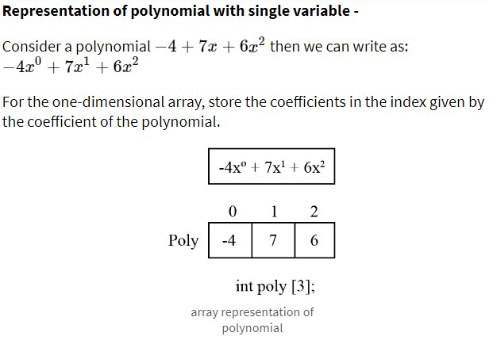
SINGLE VARIABLE POLYNOMIAL
Representation of polynomial using Array :
There may arise some situation where you need to evaluate many polynomial expressions and perform basic arithmetic operations like addition and subtraction with those numbers. For this, you will have to get a way to represent those polynomials. The simple way is to represent a polynomial with degree 'n' and store the coefficient of n+1 terms of the polynomial in the array. So every array element will consist of two values:
Coefficient and
Exponent

Slide 56
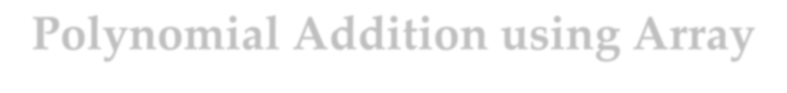
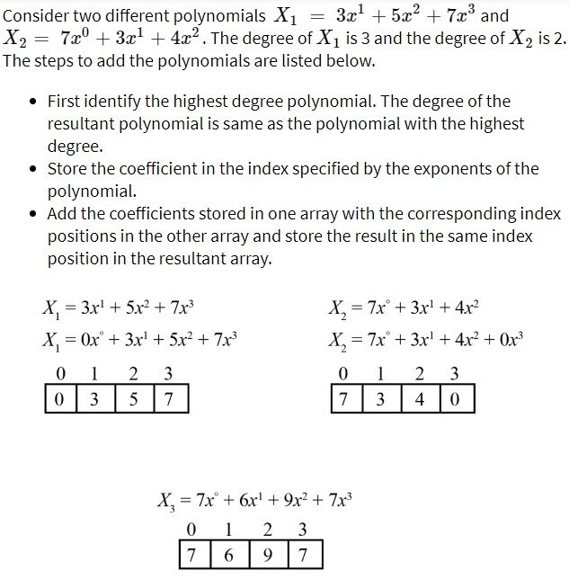
Polynomial Addition using Array

Slide 57

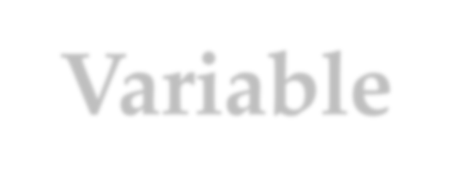

Single Variable Polynomial
Representation Using Arrays
Array of Structures
Polynomial Evaluation
Polynomial Addition
Multiplication of Two Polynomials

Slide 58

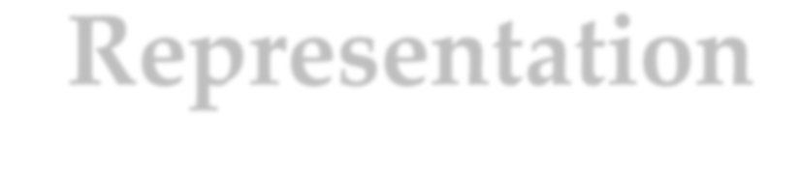
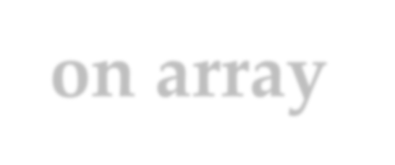
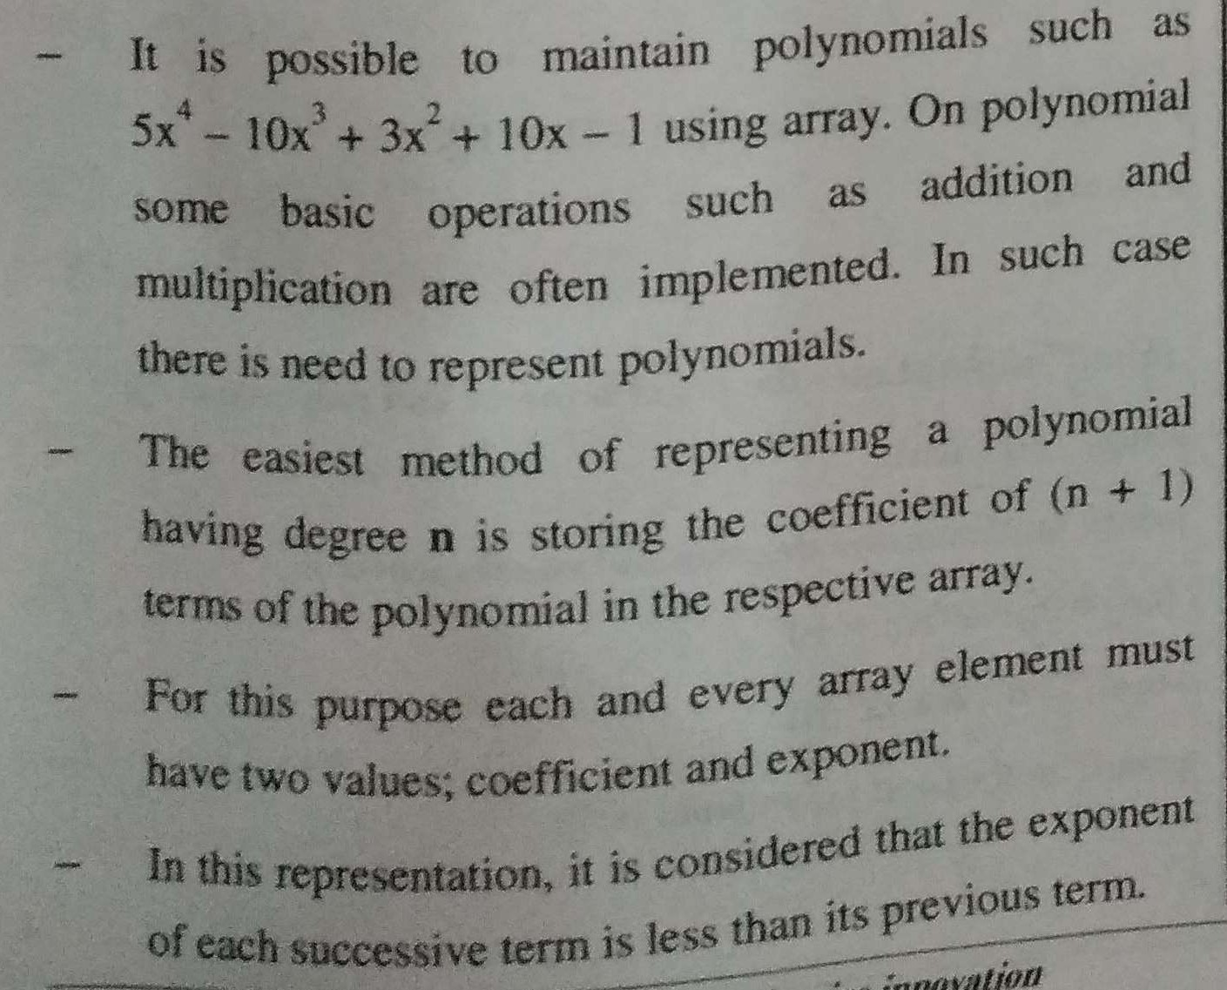
Polynomial Representation on array

Slide 59
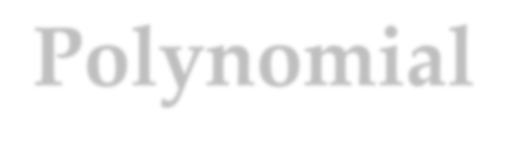
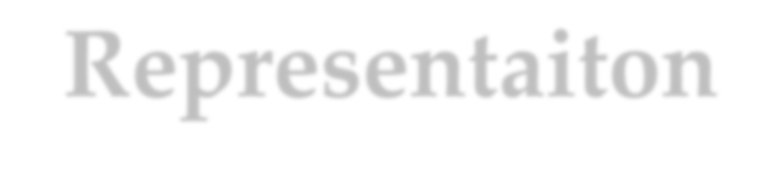
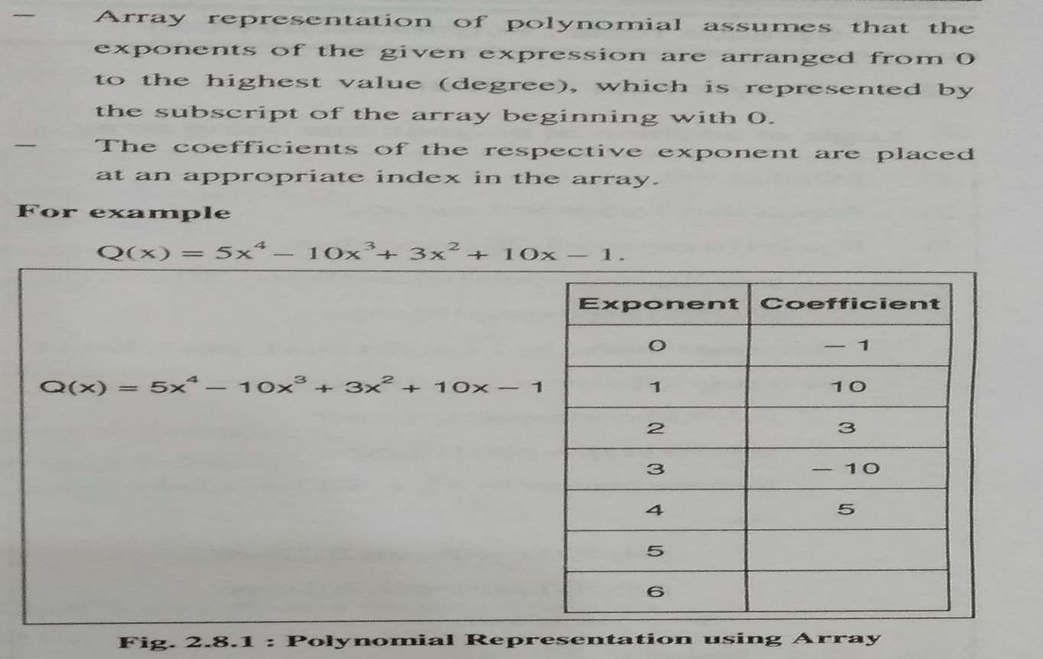
Polynomial Representaiton

Slide 60
Polynomial as an ADT, the basic operations are as follows:
Creation of a polynomial
Addition of two polynomials
Subtraction of two polynomials
Multiplication of two polynomials
Polynomial evaluation

Slide 61
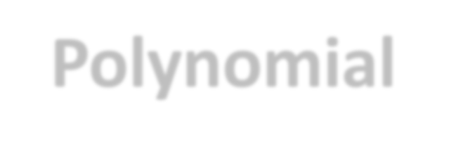

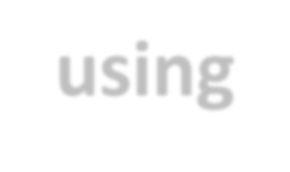
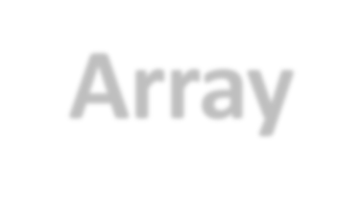


Polynomial by using Array

Slide 62





Polynomial by using Array

Slide 63





Polynomial by using structure
Let us go for structure having two data members coefficient and exponent and itsarray.

Slide 64


Addition of Two Polynomial
Given two polynomials represented by two arrays, write a function that adds given two polynomials.
Example:
Input: A[] = {5, 0, 10, 6}
B[] = {1, 2, 4}
Output: sum[] = {6, 2, 14, 6}
The first input array represents "5 + 0x^1 + 10x^2 + 6x^3" The second array represents "1 + 2x^1 + 4x^2"
And Output is "6 + 2x^1 + 14x^2 + 6x^3"

Slide 65
Addition of Two Polynomial
Example: Perform addition between polynomials 3x3-2x2+1 and 4x3+7x2-x+9.
Solution:
Step 1&2: Arrange polynomial one above the other in standard form and perform calculations.
3x3-2x2+0x+1
4x3+7x2-1x+9
(3+4)x3+(-2+7)x2+(0-1)x+1+9
Polynomial Addition : 7x3+5x2-x+10

Slide 66



Substraction of Two Polynomial
Example : Perform Subtraction between polynomials 5x3+5y2- 2z2+1 and 4x3+y2-x+2.
Solution:
Arrange polynomial one above the other in standard form and perform subtraction.
5x3+5y2-2z2+0x+1
4x3+1y2+0z2-1x+2
(5-4)x3+(5-1)y2+(-2-0)z2+(0+1)x+(1-2)
Polynomial Substraction : x3+4y2-2z2+x-1

Slide 67


SPARSE MATRIX
A matrix is a two-dimensional data object made of m rows and n columns, therefore having total m x n values. If most of the elements of the matrix have 0 value, then it is called a sparse matrix.
Why to use Sparse Matrix instead of simple matrix ?
Storage: There are lesser non-zero elements than zeros and thus lesser memory can be used to store only those elements.
Computing time: Computing time can be saved by logically designing a data structure traversing only non-zero elements.
Example: Matrix :
|0 0 3 0 4|
|0 0 5 7 0|
|0 0 0 0 0|
|0 2 6 0 0|
67

Slide 68
SPARSE MATRIX
Representing a sparse matrix by a 2D array leads to wastage of lots of memory as zeroes in the matrix are of no use in most of the cases. So, instead of storing zeroes with non-zero elements, we only store non- zero elements. This means storing non-zero elements with triples- (Row, Column, value).
Sparse Matrix Representations can be done in many ways following are two common representations:
Array representation Method 1: Using Arrays:
2D array is used to represent a sparse matrix in which there are three rows named as
Row: Index of row, where non-zero element is located
Column: Index of column, where non-zero element is located
Value: Value of the non zero element located at index – (row,column)

Slide 69

SPARSE MATRIX
Array representation Method 1: Using Arrays:
Time Complexity: O(NM), where N is the number of rows in the sparse matrix, and M is the number of columns in the sparse matrix.
Auxiliary Space: O(NM), where N is the number of rows in the sparse matrix, and M is the number of columns in the sparse matrix.

Slide 70


Sparse Logical Matrix

Slide 71


Sparse matrix and its representation

Slide 72




Transpose Of Sparse Matrix
Simple Transpose
Fast Transpose

Slide 73

Transpose Of Sparse Matrix
The transpose of a matrix is found by interchanging its rows into columns or columns into rows. The transpose of the matrix is denoted by using the letter “T” in the superscript of the given matrix. For example, if “A” is the given matrix, then the transpose of the matrix is represented by A’ or A^{T}.
The following statement generalizes the matrix transpose:
Thus Transpose of a Matrix is defined as “A Matrix which is formed by
turni^{P}n^{R}g^{OF.}a^{A}l^{N}l ^{A}t^{N}h^{D}e^{G}r^{H}o^{A}w^{RU}s of a given matrix into columns and vice-versa.”
73

Slide 74

Transpose Of Sparse Matrix
How to Find the Transpose of a Matrix?
Consider an example, if a matrix is a 2×3 matrix. It means it has 2 rows and 3 columns. While finding the transpose of a matrix, the elements in the first row of the given matrix are written in the first column of the new matrix. Similarly, the elements in the second row of the given matrix are written in the second column of the new matrix. Hence, the order of the new matrix becomes 3×2, as it has 3 rows and 2 columns.

Slide 75

Transpose Of Sparse Matrix

Slide 76







Time complexity of manual technique is O (mn).

Slide 77




Sparse matrix transpose

Slide 78


Simple Sparse matrix transpose
Time complexity will be O (n. T)
= O (n . mn)
= O (mn²)
which is worst than the conventional transpose with time complexity O (mn)

Slide 79

Python code to transpose of matrix
# Program to transpose a matrix using a nested loop
X = [[12,7],
[4 ,5],
[3 ,8]]
result = [[0,0,0],
[0,0,0]]
# iterate through rows
for i in range(len(X)):
# iterate through columns
for j in range(len(X[0])):
result[j][i] = X[i][j]
for r in result:
print(r)
79

Slide 80

Advantages of matrix
It helps in 2D Visualization.
It stores multiple elements of the same type using the same name.
Elements can be accessed using an index.
It enables access to items at random.
Any form of data with a fixed size can be stored.
It is easy to implement.
It is the simplest 2D data structure.
It is used by all programming languages.

Slide 81

Disadvantages of matrix
The matrix’s size must be known beforehand.
It is of fixed size and its size can’t be modified further.
Insertion and deletion operations are costly if shifting occurs.
Memory wastage may result if the specified matrix size is more than what is required.
Resizing a matrix can be time-consuming, especially if it needs to be done frequently or the size of the matrix is very large.
No built-in functionality..

Slide 82





Fast Transpose Of Sparse Matrix
A fast-transpose is a computer algorithm that quickly transposes a sparse matrix using a relatively small amount of memory.
Using arrays normally to record a sparse matrix uses up a lot of memory since many of the matrix's values are zero.
In addition, using the normal transpose algorithm to transpose this matrix will take O(cols*elements) amount of time.
The fast-transpose algorithm only uses a little memory to record the matrix and takes only O(cols+elements) amount of time, which is efficient considering the number of elements equals cols*rows.

Slide 83
Fast Transpose Of Sparse Matrix
Fast transpose
Algorithm computes in advance the starting array index and size for each row in the transposed matrix.
Time complexity
O(NumberOfTerms + NumberOfColumns), which is less than O(NumberOfRows * NumberOfColumns) for sparse matrices.
If matrix is not too sparse then NumberOfTerms is O(NumberOfRows * NumberOfColumns), so complexity is O(NumberOfRows * NumberOfColumns)
Pay in space complexity due to the extra.”

Slide 84




Fast Sparse matrix transpose

Slide 85

Fast Sparse matrix transpose

Slide 86




String Manipulation Using Array
It is usually formed from the character set of the programming language
The value n is the length of the character string S where n ³
0
If n = 0 then S is called a null string or empty string

Slide 87


Basically a string is stored as a sequence of characters in one- dimensional character array say A.
char A[10] ="STRING" ;
Each string is terminated by a special character that is null character ‘\0’.
This null character indicates the end or termination of each string.
87

Slide 88
There are various operations that can be performed on the string:
To find the length of a string
To concatenate two strings
To copy a string
To reverse a string
String compare
Palindrome check
To recognize a sub string
88

Slide 89
Write a program to reverse string.
#include<iostream> #include<string.h> using namespace std; int main ()
{
char str[50], temp; int i, j;
cout << "Enter a string : "; Cin>>str;
j = strlen(str) - 1;
for (i = 0; i < j; i++,j--)
{
temp = str[i]; str[i] = str[j]; str[j] = temp;
}
cout << "\nReverse string : " << str;
^{return}PR⁰O; F. ANAND GHARU
89
}

Slide 90
/* C++ Program - Concatenate String using inbuilt function */
#include<iostream.h> #include<string.h>
void main()
{
clrscr();
char str1[50], str2[50]; cout<<"Enter first string : "; Cin>>str1;
cout<<"Enter second string : "; cin>>str2;
strcat(str1, str2);
cout<<"String after concatenation is "<<str1; getch();
}
90

Slide 91
/* C++ Program - Concatenate String without using inbuilt function */
#include <iostream> using namespace std; int main()
{
char str1[100] = "Hi...";
char str2[100] = "How are you"; int i,j;
cout<<"String 1: "<<str1<<endl;
cout<<"String 2: "<<str2<<endl; for(i = 0; str1[i] != '\0'; ++i);
j=0;
while(str2[j] != '\0')
{
str1[i] = str2[j]; i++; j++;
}
str1[i] = '\0';
cout<<"String after concatenation: "<<str1; return 0;
}
91

Slide 92
Find length of string without using strlen function
#include<iostream> using namespace std; int main()
To get the length of a C-string string, strlen() function is used.
#include <iostream>
#include <cstring> using namespace std; int main()
{
char str[] = "C++ Programming is awesome";
// you can also use str.length()
cout << "String Length = " << strlen(str);
return 0;
}
{
char str[] = "Apple"; int count = 0;
while (str[count] != '\0') count++;
cout<<"The string is "<<str<<endl; cout
<<"The length of the string is "<<count<<endl;
return 0;
}
92

Slide 93
/* C++ Program - Compare Two String */
#include<iostream.h> #include<string.h> void main()
{
clrscr();
char str1[100], str2[100]; cout<<"Enter first string : "; gets(str1);
cout<<"Enter second string : "; gets(str2);
if(strcmp(str1, str2)==0)
{
cout<<"Both the strings are equal";
}
else
{ cout<<"Both the strings are not equal";
} getch(); }
93

Slide 94
#include <iostream> #include <string.h> using namespace std; int main()
String is palindrom or not
{
char str1[20], str2[20]; int i, j, len = 0, flag = 0;
cout << "Enter the string : "; gets(str1);
len = strlen(str1) - 1;
for (i = len, j = 0; i >= 0 ; i--, j++) str2[j] = str1[i];
if (strcmp(str1, str2))
flag = 1;
if (flag == 1)
cout << str1 << " is not a palindrome"; else
cout << str1 << " is a palindrome";
return 0;
}
94

Slide 95
SIMPLE TRANSPOSE OF MATRIX IN C++
{ cout << " " << a[i][j]; if(j == c - 1)
cout << endl << endl; }
// Finding transpose of matrix a[][] and storing it infor(i = 0; i < r; ++i)
for(j = 0; j < c; ++j)
{
trans[j][i]=a[i][j];
}
// Displaying the transpose
cout << endl << "Transpose of Matrix: " << endl; for(i = 0; i < c; ++i)
for(j = 0; j < r; ++j)
{
cout << " " << trans[i][j]; if(j == r - 1)
cout << endl << endl;
}
95
#include <iostream> using namespace std; int main()
{
int a[10][10], trans[10][10], r, c, i, j;
cout << "Enter rows and columns of matrix: "; cin >> r >> c;// Storing element of matrix
cout << endl << "Enter elements of matrix: " << endl;
for(i = 0; i < r; ++i) for(j = 0; j < c; ++j)
{
cout << "Enter elements a" << i + 1 << j + 1 << ": ";
cin >> a[i][j];
} // Displaying the matrix a[][]
cout << endl << "Entered Matrix: " << endl;
for(i = 0; i < r; ++i)
return 0; }
for(j = 0; j < c; ++j)

Slide 96
MULTIPLICATION OF TWO POLYNOMIAL
switch(option)
{
case 1:read(p1);break; case 2:read(p2);break; case 3:add(p1,p2,p3);
printf(“n1’st polynomial -> “); print(p1);
printf(“n2’nd polynomial -> “); print(p2);
printf(“n Sum = “); print(p3);
break;
case 4:multiply(p1,p2,p3); printf(“n1’st polynomial -> “); print(p1);
printf(“n2’nd polynomial -> “); print(p2);
printf(“n Product = “);
print(p3);
break;
}
}while(option!=5);
}
#include<math.h> #include<stdio.h> #include<conio.h> #define MAX 17 void init(int p[]); void read(int p[]); void print(int p[]);
void add(int p1[],int p2[],int p3[]); void multiply(int p1[],int p2[],int p3[]);
/*Polynomial is stored in an array, p[i] gives coefficient of x^i .
a polynomial 3x^2 + 12x^4 will be represented as (0,0,3,0,12,0,0,….)
*/
void main()
{
int p1[MAX],p2[MAX],p3[MAX];
int option; do
{
printf(“nn1 : create 1’st polynomial”); printf(“n2 : create 2’nd polynomial”); printf(“n3 : Add polynomials”); printf(“n4 : Multiply polynomials”); printf(“n5 : Quit”);
printf(“nEnter your choice :”);
scanf(“%d”,&option);
96

Slide 97
MULTIPLICATION OF TWO POLYNOMIAL
void multiply(int p1[], int p2[], int p3[])
{
int i,j;
init(p3); for(i=0;i<MAX;i++) for(j=0;j<MAX;j++)
p3[i+j]=p3[i+j]+p1[i]*p2[j];
}
void init(int p[])
{
int i; for(i=0;i<MAX;i++)
p[i]=0;
}
*******END******
void read(int p[])
{
int n, i, power,coeff; init(p);
printf(“n Enter number of terms :”); scanf(“%d”,&n);
/* read n terms */ for (i=0;i<n;i++)
{ printf(“nenter a term(power coeff.)”); scanf(“%d%d”,&power,&coeff); p[power]=coeff;
}
}
void print(int p[])
{
int i; for(i=0;i<MAX;i++) if(p[i]!=0)
printf(“%dX^%d “,p[i],i);
}
void add(int p1[], int p2[], int p3[])
{
int i; for(i=0;i<MAX;i++)
p3[i]=p1P[RiO]+Fp. A2N[iA];ND GHARU
}
97

Slide 98
FIND SIMPLE TRANSPOSE OF MATRIX
// Displaying the matrix a[][]
cout << endl << "Entered Matrix: " << endl;
for(i = 0; i < r; ++i)
for(j = 0; j < c; ++j)
{
cout << " " << a[i][j]; if(j == c - 1)
cout << endl << endl;
}
// Finding transpose of matrix a[][] and storing it in array trans[][].
for(i = 0; i < r; ++i) for(j = 0; j < c; ++j)
{
trans[j][i]=a[i][j];
}
#include <iostream> using namespace std; int main()
{
int a[10][10], trans[10][10], r, c, i, j;
cout << "Enter rows and columns of matrix: ";
cin >> r >> c;
//Storing element of matrix enter by user in array a[][]. cout << endl << "Enter elements of matrix: " << endl; for(i = 0; i < r; ++i)
for(j = 0; j < c; ++j)
{
cout << "Enter elements a" << i + 1 << j + 1 << ":
";
cin >> a[i][j];
}
98

Slide 99
FIND SIMPLE TRANSPOSE OF MATRIX
// Displaying the transpose,i.e, Displaying array trans[][].
cout << endl << "Transpose of Matrix: " <<
endl;
for(i = 0; i < c; ++i) for(j = 0; j < r; ++j)
{
cout << " " << trans[i][j]; if(j == r - 1)
cout << endl << endl;
}
return 0;
}
99

Slide 100
REFERENCES
https://dotnettutorials.net/lesson/array-abstract-data-type-in-c/
https://www.tutorialspoint.com/adt-array-representation-in-data-structure
https://www.codingninjas.com/studio/library/c-program-to-merge-two- sorted-array-in-ascending-order
https://quescol.com/interview-preparation/merge-two-arrays-python
https://www.faceprep.in/data-structures/introduction-to-arrays/
https://www.geeksforgeeks.org/calculation-of-address-of-element-of-1-d-2- d-and-3-d-using-row-major-and-column-major-order/
https://www.w3schools.in/data-structures/polynomials-using-linked-list- and- arrays#:~:text=Representation%20of%20Polynomials%20Using%20Arrays &text=The%20simple%20way%20is%20to,Exponent
https://www.bartleby.com/subject/engineering/computer- science/concepts/representation-of-polynomial
https://www.geeksforgeeks.org/sparse-matrix-representation/
https://byjus.com/maths/transpose-of-a-matrix/
11.h^{P}tt^{R}p^{O}s^{F.}:^{A}//^{N}w^{A}w^{ND}w^{G}.^{H}y^{A}o^{R}u^{U} tube.com/watch?v=zXioPdQXf9A
100

Slide 101
THANK YOU!!!
1
0
1

